Slide 1
Self-Perceptions & Self-Esteem

Slide 2
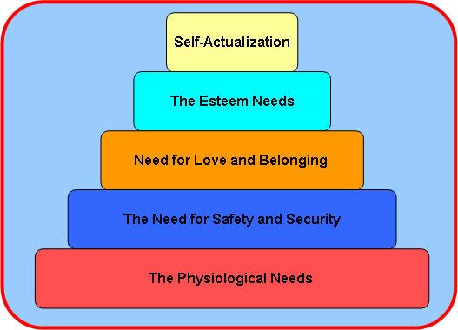
What do we need in life?
(According to Maslow, 1943)
Notes:
Physiology – basic life needs – food, air, water, sleep, sex
Safety and security – law, boundaries, protection
Love and belonging – family, relationships, affection
The esteem needs – achievement, status, reputation
Self-actualisation – self-fulfilment and personal growth
Learning and knowledge is between esteem and self-actualisation

Slide 3
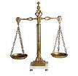
Definition…
A sum…
How we would like to be – how we actually are = SELF-ESTEEM
Self-esteem is a value judgement
Self-esteem is fluid and can be influenced by different factors in our lives
The ‘negative bias’
Notes:
Self perception is how you see yourself whereas esteem contains a value or comparative factor i.e. how you see your actual self against the self you would like to be.
The brain is wired to remember and recall when things go wrong more easily. In the past this put us at an evolutionary advantage – those who identified and remember potential hazards survived. Now it has no such purpose.

Slide 4
Self-perceptions
As a fundamental aspect of self-esteem it is vital that we understand a child’s self-perceptions before we can begin to raise their self-esteem.
We need to understand how they see themselves as well as how they would like to be.
How?
Notes:
Many ways to unpick self-perceptions. Psychologists and researchers spent a lot of time over the years on this area.

Slide 5
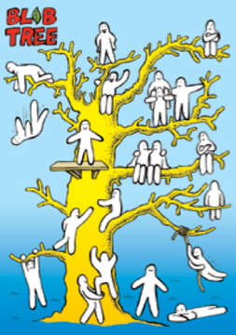
The Blob Tree
Notes:
Can be used to gauge social skills, self-perceptions, tool for talking etc
Personal qualities and values
Can you colour in the person who is most like you?
How come you chose that one?
Is that important to you?
Which one is not at all like you?
How come you chose that one?
Is it important to be…?
What is the opposite of that?
Social skills
How is this one feeling do you think? How come you said that? Is there anyone that is feeling the same/different? Is it important to be…? Do you think they should change? What could they do differently?

Slide 6
Blob Tree questions
Personal qualities and values
Can you colour in the person who is most like you?
How come you chose that one?
Is that important to you?
Which one is not at all like you?
How come you chose that one?
Is it important to be…?
What is the opposite of that?
Would you like to be more…?
Social skills
How is this one feeling do you think? How come you said that? Is
There anyone that is feeling the same/different? Is it important
to be…? Do you think they should change? What could they do differently?
Notes:
ACTIVITY – VOLUNTEER?
Who do you like/dislike
Who did you notice first?
NEVER ASK WHY

Slide 7

3 things
Who knows you best? (at home/school/other)
If I was going to find out about you and I asked this person what you are like, what three things would they say?
Would they be right? Would you agree?
Prompt if they respond with factual or physical attributes
Notes:
ACTIVITY – VOLUNTEER?
Never tell them they are wrong though

Slide 8
Salmon Line
e.g. shy in class
e.g. puts hand up in class
CURRENT STATE
DESIRED STATE
Where would be ‘good enough’?
Is it possible?
How will it begin to happen? How will you know?
What will it look like?
Who can help? What will they need to do?
Who will be first to notice? What will they notice?
How will you know they have noticed?

Slide 9
The Importance of Genuine Praise
Insincerity builds resentment and disrespect.
Get to know the child and refer to their own interests – they will feel more valued and recognised as an individual.
Try to turn a failure into a ‘learning experience’ e.g. “You have worked carefully and just had one step out of order. Once you fix it, you will be able to figure out the rest”.
Express confidence in their abilities.
Praise for BEING and praise for DOING. Have a go!
Notes:
ACTIVITY – HAVE A GO AT THESE TWO TYPES OF PRAISE WITH EACH OTHER – WHICH FEELS BETTER? WHICH IS EASIER TO DO

Slide 10
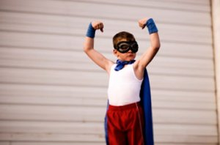
Identifying Strengths
Creativity
Love of learning
Enthusiasm
Persistence
Courage
Honesty
Fairness
Teamwork
Leadership
Kindness
Friendship
Generosity
Humour
Forgiveness
Self-control
Modesty
Patience
energetic
Notes:
Start to use the words in your every day language in the class room
Give the child the opportunity to provide feedback, let them tell you why they think you are pleased with them.

Slide 11


Teach Optimism
A tricky situation
PESSIMISM
I can’t do this
What’s the point in trying?
I’m no good at anything
If I’m successful it’s because the task was easy
OPTIMISM
I can do this
I have the talent to be able to do it
If I keep trying I will be able to do it
Even if I make a mistake I still do other things well
LOSS OF CONFIDENCE
GIVE UP
INCREASED CONFIDENCE
STICK WITH IT
Notes:
Show them the thought patterns that belong to each outcome
Attribution theory – depressed people attribute positive things as caused by an external factor and negative things as their own fault (internal)

Slide 12
WWW?
Activity
Neural plasticity and the negative bias
Encourage the child to have a diary, a journal or doodle book to record ‘What Went Well?’ – they can share it with you or not (the exercise is really about the process of thinking about it rather than the outcome)
Observe successes in areas you know are of value to them.
Notes:
Tell your neighbour about something that has gone well this week, something you were pleased about , happy with, surprised etc

Slide 13
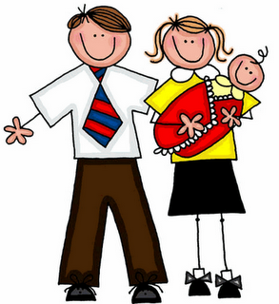
Recruiting parents
Send notes home detailing what the child has done well
See handout – advice for parents
Parental confidence?
Notes:
Detail specifics about what went well

Slide 14
The importance of confidence
Did you know?
Confidence is contagious! Research has shown that teachers with high confidence in their teaching ability create confident pupils. Parents who have confidence in their ability as a parent improve their children’s self-beliefs and capabilities. (Pajares, 2005)

